Slide 1
AWS ROUTE53

Slide 2
Agenda
What is Route 53?
Why do we need Route 53?
How it works?
Features of Route 53
Types of Route 53
Benefits of Route 53

Slide 3
What is Amazon Route 53?
AWS Route 53 is a highly available and scalable DNS Web service. It gives businesses and developers a cost-effective way to route end users to internet applications by translating the domain names into IP address

Slide 4
Why do we need Route 53?
Simple Routing Policy
High availability and scalable
Geolocation routing
Latency Based Routing

Slide 5
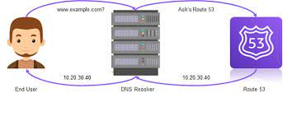
How it works?

Slide 6
Types of Routing Policy
Simple Routing policy:
Failover routing policy
Geolocation Routing policy
Latency Routing policy

Slide 7
Benefits of Route 53
High Available and Reliable
Flexible
Simple
Cost Effective
Designed to Integrated with other AWS Services

